Slide 1

HIT THE CHARTS

Slide 2
MOTIVATION

Slide 3

ARTIST
WHATS THE SINGLE?
MGMT
LABEL
PR / PUBLICIST

Slide 4
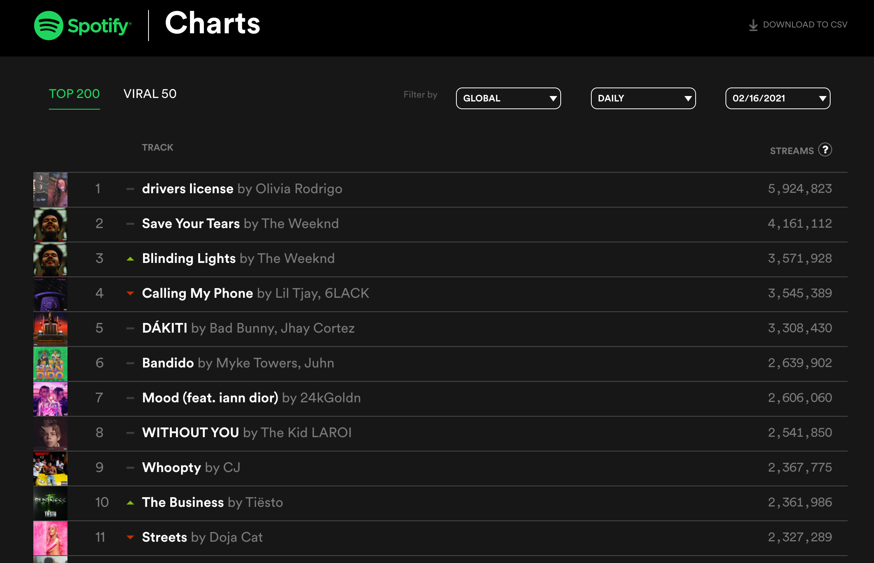
33 COUNTRIES
01/01/2018 -
31/01/2021
TOP 50
EVERY 90 DAYS
9.000
UNIQUE SONGS

Slide 5
ANALYSIS

Slide 6
Speechiness:
presence of spoken words
Tempo: (BPM).
Valence: positiveness
Liveness:
presence of an audience
Danceability
Acousticness
Energy
Instrumentalness
Loudness in decibels (dB)

Slide 7
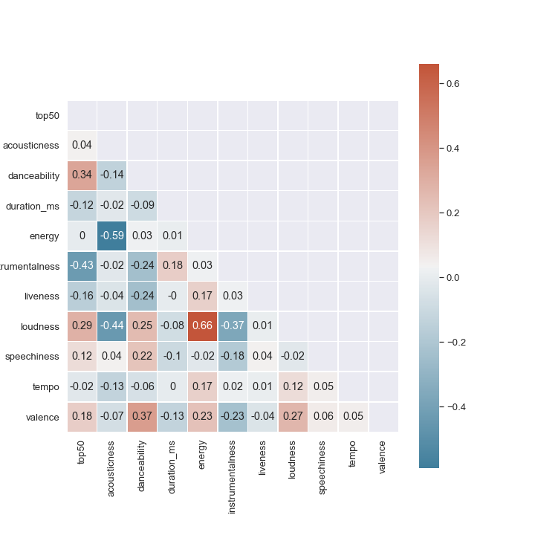

Slide 8
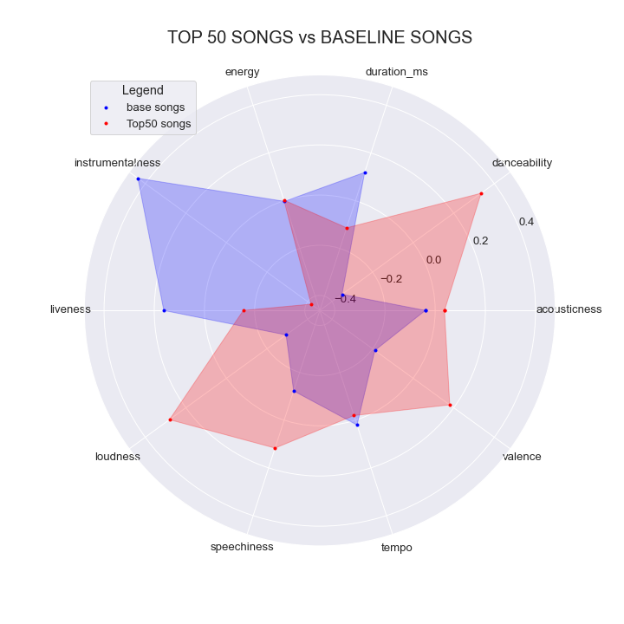

Slide 9
MODEL COMPARISON

Slide 10
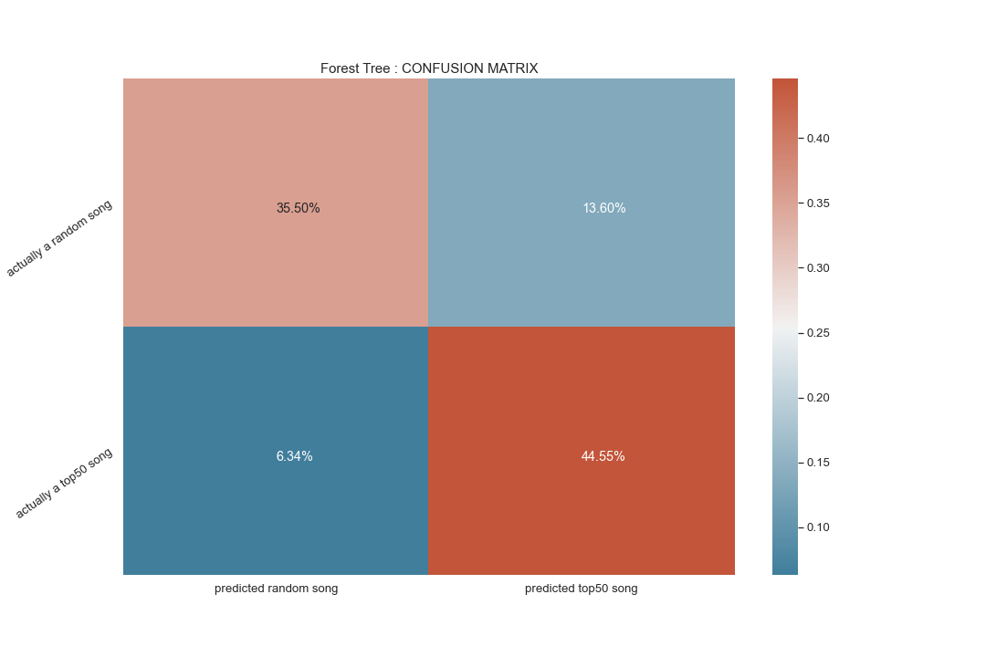

Slide 11
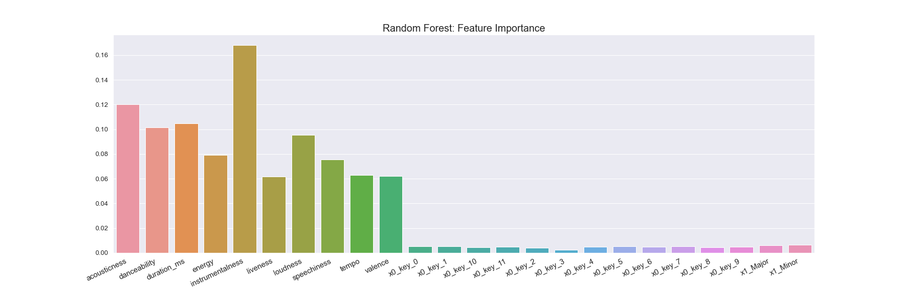

FEATURE IMPORTANCE

